Slide 1
Benefits of a Fitness Tracker
Presented By: Jarides Bruna
On: 09/16/2023

Slide 2
Business Task
Objective
Analyze data from users of a popular fitness tracker brand named Fitbit, to find trends in their use and how we, at bellabeat, can benefit from the information.
Use insight gained to help structure a marketing strategy for one of our comparable products.
Data was obtained from 33 users via survey with their consent and understanding.
Not all the data fields were completed and demographics of the users surveyed was not included, so data bias can not be ruled out.
Survey was taken over the span of 31 days not enough to offer long term insight, and almost half of the survey takers submitted less than 25 days of observations.
Dates surveyed were from April 12, 2016 to March 12, 2016, classifying the data outdated.
For a more accurate and relevant analysis I suggest using a survey that is current and surveying a new group of users for a longer period of time.

Slide 3
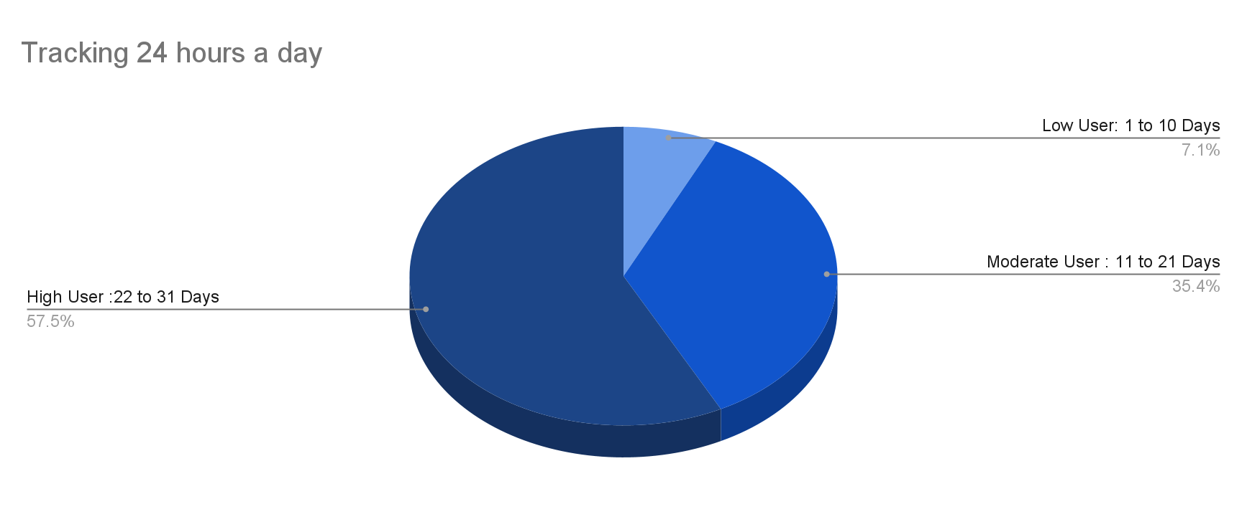
Once they put it on they don’t take it off.
Data shows that most users wear the tracker on an average of 23 hours a day. Most of the reasons users listed for taking off their fitbit included:
Developing a rash from band
Recharging the battery (can take upto a full 2 hours to charge)
Changing up the look for something more fitting of their outfit.

Slide 4
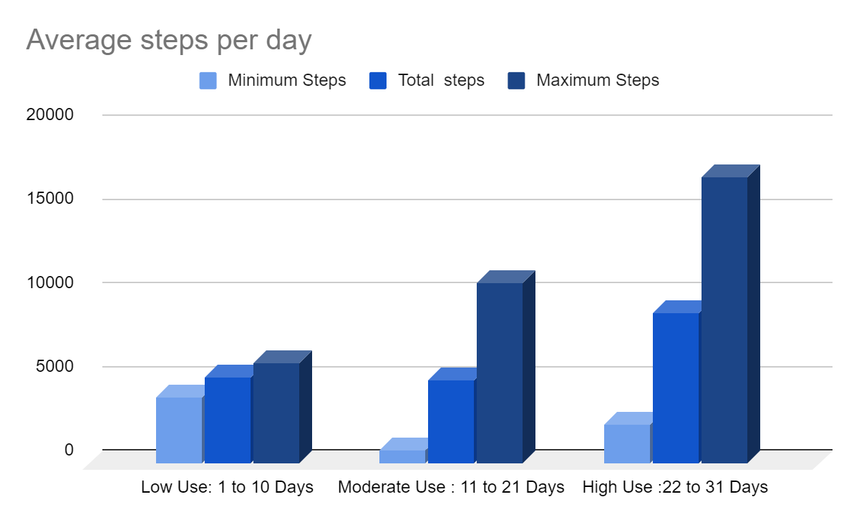
Using a fitness tracker = more steps
Users that wore their trackers more than 21 days a month took an average of 57% more steps than the users that wore it less than 11 days a month.
According to John Hopkins School of Medicine: Studies show that consistently using a fitness tracker—a device that tracks your movement, such as a traditional pedometer or other wearable device, or a smartphone app—can increase your steps per day by more than a mile, especially if you establish a heart-smart daily goal.

Slide 5
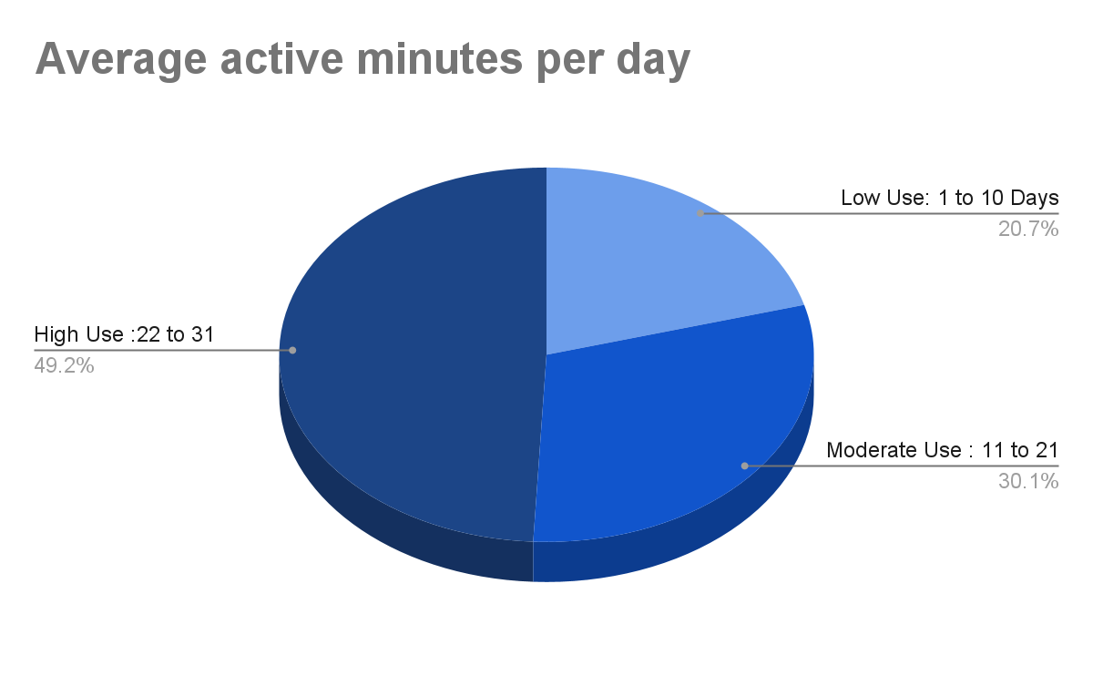
Active minutes increase
On average low users recorded 35 active minutes a day, moderate users 51 active minutes a day and high users 83 active minutes a day.
The notification option on Fitbit reminds you to move a certain amount of steps per hour in accordance to your daily step goal. This in turn causes users to be aware of any sedentary habits they might have and helps them to be mindful and move more .

Slide 6
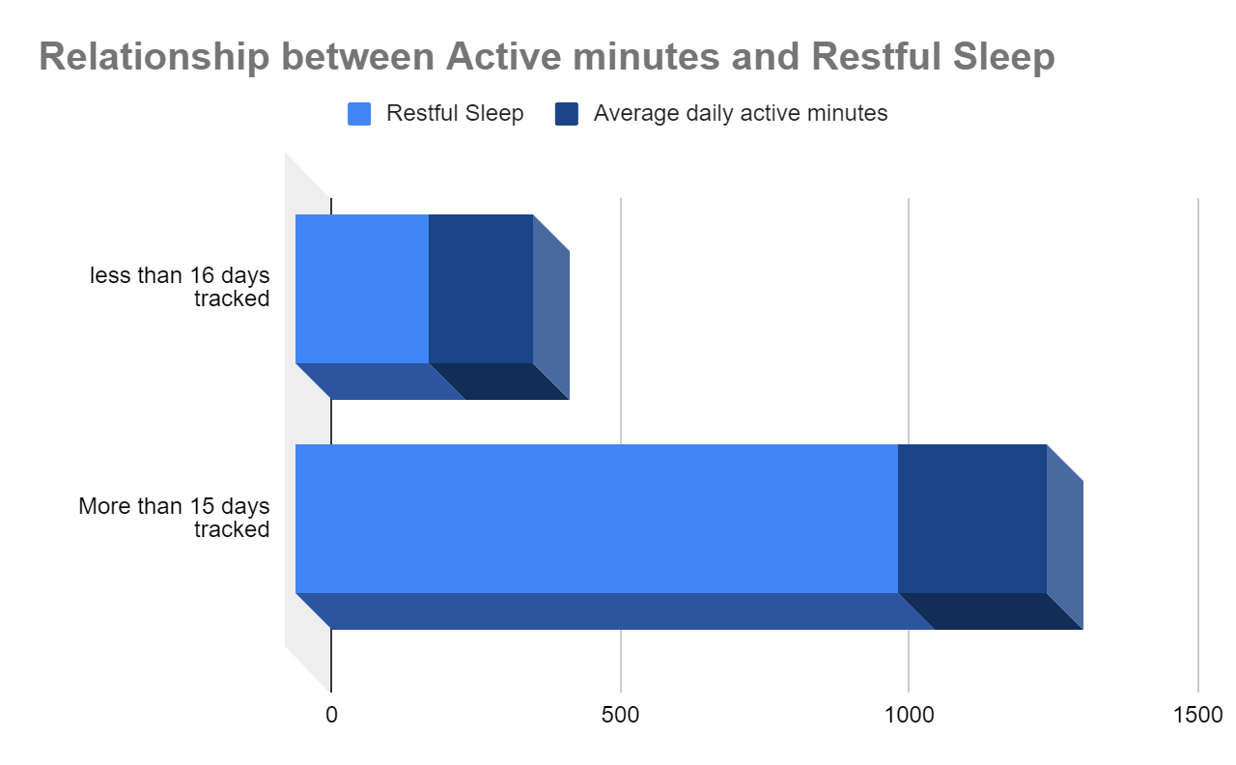
Getting restful sleep
User recorded a 1.32% increase of restful sleep when using their trackers more than 15 days a month than those that wore it less than 16 days a month.
According to the National Library of Medicine: Exercise has long been associated with better sleep, and evidence is accumulating on the efficacy of exercise as a nonpharmacologic treatment option for disturbed sleep. Recent research, however, has noted that poor sleep may contribute to low physical activity levels, emphasizing a robust bidirectional relationship between exercise and sleep.

Slide 7
Conclusion
While we essentially offer the same benefits as a Fitbit through biometrics and user dashboard, that is where our similarities end.
We should concentrate our marketing strategies on highlighting:
We are a company that is specifically designed with women in mind.
Our leaf tracker is not only stylish, but it can be used to accessorize any wardrobe with its different wearability functions and customizations.
The band being thinner than traditional trackers makes it not only visually appealing but also less likely to cause a rash due to minimal skin contact and high-quality silicone.
Only wearable that can also be worn on a necklace maintaining it’s stylish design.
Since the user can wear it longer without having to worry about charging the battery, they can gain better a perception on their health with continuous uninterrupted monitoring.
The newest models of Fitbit have shifted from fitness trackers to smartwatches and their battery life has decreased in the process..
While Leaf, continues to focus more on the well being of the user, and our non-intrusive design helps to keep battery life for upto six months.
Overall fitness trackers offer users an insight into their healthy and unhealthy habits that can help them to live healthier lifestyles. The data obtained proves the benefits of fitness trackers and with our company focusing on “Empowering Women to Unlock Their Full Potential”, we are the best suited for the task.

